Slide 1
Data Mining:
Concepts and Techniques
— Chapter 2 —
Data Mining: Concepts and Techniques

Slide 2
Chapter 2: Data Preprocessing
Why preprocess the data?
Descriptive data summarization
Data cleaning
Data integration and transformation
Data reduction
Discretization and concept hierarchy generation
Summary
Data Mining: Concepts and Techniques

Slide 3
Data Transformation
Smoothing: remove noise from data
Aggregation: summarization, data cube construction
Generalization: concept hierarchy climbing
Normalization: scaled to fall within a small, specified range
  min-max normalization
  z-score normalization
  normalization by decimal scaling
Attribute/feature construction
  New attributes constructed from the given ones
Data Mining: Concepts and Techniques

Slide 4
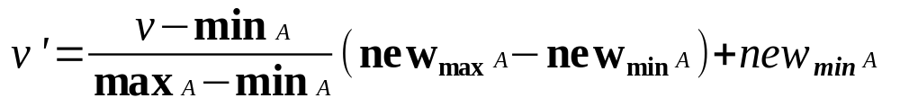
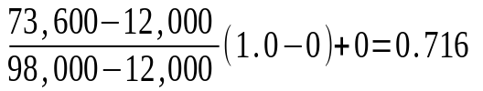
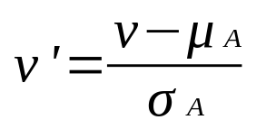
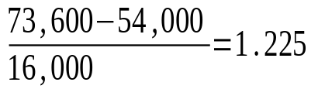
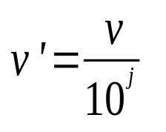
Data Transformation: Normalization
Min-max normalization: to [new_min_{A}, new_max_{A}]
  Ex. Let income range $12,000 to $98,000 normalized to [0.0, 1.0]. Then $73,000 is mapped to
Z-score normalization (μ: mean, σ: standard deviation):
  Ex. Let μ = 54,000, σ = 16,000. Then
Normalization by decimal scaling
  Ex. A ranging from -986 to 917 is mapped to –0.986 to 0.917
Where j is the smallest integer such that Max(|ν’|) < 1
Data Mining: Concepts and Techniques

Slide 5
Chapter 2: Data Preprocessing
Why preprocess the data?
Data cleaning
Data integration and transformation
Data reduction
Discretization and concept hierarchy generation
Summary
Data Mining: Concepts and Techniques

Slide 6
Data Reduction Strategies
Why data reduction?
  A database/data warehouse may store terabytes of data
  Complex data analysis/mining may take a very long time to run on the complete data set
Data reduction
  Obtain a reduced representation of the data set that is much smaller in volume but yet produce the same (or almost the same) analytical results
Data reduction strategies
  Data cube aggregation:
  Dimensionality reduction — e.g., remove unimportant attributes
  Data Compression
  Numerosity reduction — e.g., fit data into models
  Discretization and concept hierarchy generation
Data Mining: Concepts and Techniques

Slide 7
Data Cube Aggregation
The lowest level of a data cube (base cuboid)
  The aggregated data for an individual entity of interest
  E.g., a customer in a phone calling data warehouse
Multiple levels of aggregation in data cubes
  Further reduce the size of data to deal with
Reference appropriate levels
  Use the smallest representation which is enough to solve the task
Queries regarding aggregated information should be answered using data cube, when possible
Data Mining: Concepts and Techniques

Slide 8
Attribute Subset Selection
Feature selection (i.e., attribute subset selection):
  Select a minimum set of features such that the probability distribution of different classes given the values for those features is as close as possible to the original distribution given the values of all features
  reduce # of patterns in the patterns, easier to understand
Heuristic methods (due to exponential # of choices):
  Step-wise forward selection
  Step-wise backward elimination
  Combining forward selection and backward elimination
  Decision-tree induction
Data Mining: Concepts and Techniques

Slide 9
Example of Decision Tree Induction
Initial attribute set:
{A1, A2, A3, A4, A5, A6}
A4 ?
A1?
A6?
Class 1
Class 2
Class 1
Class 2
>
Reduced attribute set: {A1, A4, A6}
Data Mining: Concepts and Techniques

Slide 10
Data Compression
String compression
  There are extensive theories and well-tuned algorithms
  Typically lossless
  But only limited manipulation is possible without expansion
Audio/video compression
  Typically lossy compression, with progressive refinement
  Sometimes small fragments of signal can be reconstructed without reconstructing the whole
Time sequence is not audio
  Typically short and vary slowly with time
Data Mining: Concepts and Techniques

Slide 11
Data Compression
Original Data
Compressed
Data
lossless
Original Data
Approximated
lossy
Data Mining: Concepts and Techniques

Slide 12
Dimensionality Reduction:
Wavelet Transformation
Haar2
Daubechie4
Discrete wavelet transform (DWT): linear signal processing, multi-resolutional analysis
Compressed approximation: store only a small fraction of the strongest of the wavelet coefficients
Similar to discrete Fourier transform (DFT), but better lossy compression, localized in space
Method:
  Length, L, must be an integer power of 2 (padding with 0’s, when necessary)
  Each transform has 2 functions: smoothing, difference
  Applies to pairs of data, resulting in two set of data of length L/2
  Applies two functions recursively, until reaches the desired length
Data Mining: Concepts and Techniques

Slide 13

DWT for Image Compression
Image
Low Pass High Pass
Low Pass High Pass
Low Pass High Pass
Data Mining: Concepts and Techniques

Slide 14
Dimensionality Reduction: Principal Component Analysis (PCA)
Given N data vectors from n-dimensions, find k ≤ n orthogonal vectors (principal components) that can be best used to represent data
Steps
  Normalize input data: Each attribute falls within the same range
  Compute k orthonormal (unit) vectors, i.e., principal components
  Each input data (vector) is a linear combination of the k principal component vectors
  The principal components are sorted in order of decreasing “significance” or strength
  Since the components are sorted, the size of the data can be reduced by eliminating the weak components, i.e., those with low variance. (i.e., using the strongest principal components, it is possible to reconstruct a good approximation of the original data
Works for numeric data only
Used when the number of dimensions is large
Data Mining: Concepts and Techniques

Slide 15
Principal Component Analysis
X2
Y1
Y2
X1
Data Mining: Concepts and Techniques

Slide 16
Numerosity Reduction
Reduce data volume by choosing alternative, smaller forms of data representation
Parametric methods
  Assume the data fits some model, estimate model parameters, store only the parameters, and discard the data (except possible outliers)
  Example: Log-linear models—obtain value at a point in m-D space as the product on appropriate marginal subspaces
Non-parametric methods
  Do not assume models
  Major families: histograms, clustering, sampling
Data Mining: Concepts and Techniques

Slide 17
Data Reduction Method (1): Regression and Log-Linear Models
Linear regression: Data are modeled to fit a straight line
  Often uses the least-square method to fit the line
Multiple regression: allows a response variable Y to be modeled as a linear function of multidimensional feature vector
Log-linear model: approximates discrete multidimensional probability distributions
Data Mining: Concepts and Techniques

Slide 18
Regress Analysis and Log-Linear Models
Linear regression: Y = w X + b
  Two regression coefficients, w and b, specify the line and are to be estimated by using the data at hand
  Using the least squares criterion to the known values of Y1, Y2, …, X1, X2, ….
Multiple regression: Y = b0 + b1 X1 + b2 X2.
  Many nonlinear functions can be transformed into the above
Log-linear models:
  The multi-way table of joint probabilities is approximated by a product of lower-order tables
  Probability: p(a, b, c, d) = αab βacχad δbcd
Data Mining: Concepts and Techniques

Slide 19

Data Reduction Method (2): Histograms
Divide data into buckets and store average (sum) for each bucket
Partitioning rules:
  Equal-width: equal bucket range
  Equal-frequency (or equal-depth)
  V-optimal: with the least histogram variance (weighted sum of the original values that each bucket represents)
  MaxDiff: set bucket boundary between each pair for pairs have the β–1 largest differences
Data Mining: Concepts and Techniques

Slide 20
Data Reduction Method (3): Clustering
Partition data set into clusters based on similarity, and store cluster representation (e.g., centroid and diameter) only
Can be very effective if data is clustered but not if data is “smeared”
Can have hierarchical clustering and be stored in multi-dimensional index tree structures
There are many choices of clustering definitions and clustering algorithms
Cluster analysis will be studied in depth in Chapter 7
Data Mining: Concepts and Techniques

Slide 21
Data Reduction Method (4): Sampling
Sampling: obtaining a small sample s to represent the whole data set N
Allow a mining algorithm to run in complexity that is potentially sub-linear to the size of the data
Choose a representative subset of the data
  Simple random sampling may have very poor performance in the presence of skew
Develop adaptive sampling methods
  Stratified sampling:
    Approximate the percentage of each class (or subpopulation of interest) in the overall database
    Used in conjunction with skewed data
Note: Sampling may not reduce database I/Os (page at a time)
Data Mining: Concepts and Techniques

Slide 22
Sampling: with or without Replacement
SRSWOR
(simple random
sample without
replacement)
SRSWR
Raw Data
Data Mining: Concepts and Techniques

Slide 23
Sampling: Cluster or Stratified Sampling
Raw Data
Cluster/Stratified Sample
Data Mining: Concepts and Techniques

Slide 24
Chapter 2: Data Preprocessing
Why preprocess the data?
Data cleaning
Data integration and transformation
Data reduction
Discretization and concept hierarchy generation
Summary
Data Mining: Concepts and Techniques

Slide 25
Discretization
Three types of attributes:
  Nominal — values from an unordered set, e.g., color, profession
  Ordinal — values from an ordered set, e.g., military or academic rank
  Continuous — real numbers, e.g., integer or real numbers
Discretization:
  Divide the range of a continuous attribute into intervals
  Some classification algorithms only accept categorical attributes.
  Reduce data size by discretization
  Prepare for further analysis
Data Mining: Concepts and Techniques

Slide 26
Discretization and Concept Hierarchy
Discretization
  Reduce the number of values for a given continuous attribute by dividing the range of the attribute into intervals
  Interval labels can then be used to replace actual data values
  Supervised vs. unsupervised
  Split (top-down) vs. merge (bottom-up)
  Discretization can be performed recursively on an attribute
Concept hierarchy formation
  Recursively reduce the data by collecting and replacing low level concepts (such as numeric values for age) by higher level concepts (such as young, middle-aged, or senior)
Data Mining: Concepts and Techniques

Slide 27
Discretization and Concept Hierarchy Generation for Numeric Data
Typical methods: All the methods can be applied recursively
  Binning (covered above)
    Top-down split, unsupervised,
  Histogram analysis (covered above)
    Top-down split, unsupervised
  Clustering analysis (covered above)
    Either top-down split or bottom-up merge, unsupervised
  Entropy-based discretization: supervised, top-down split
  Interval merging by χ² Analysis: unsupervised, bottom-up merge
  Segmentation by natural partitioning: top-down split, unsupervised
Data Mining: Concepts and Techniques

Slide 28
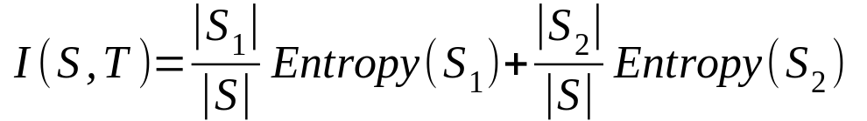
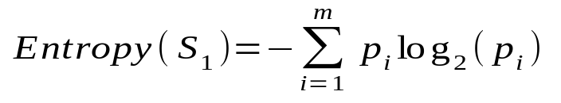
Entropy-Based Discretization
Given a set of samples S, if S is partitioned into two intervals S₁ and S₂ using boundary T, the information gain after partitioning is
Entropy is calculated based on class distribution of the samples in the set. Given m classes, the entropy of S₁ is
  where p_{i} is the probability of class i in S₁
The boundary that minimizes the entropy function over all possible boundaries is selected as a binary discretization
The process is recursively applied to partitions obtained until some stopping criterion is met
Such a boundary may reduce data size and improve classification accuracy
Data Mining: Concepts and Techniques

Slide 29
Interval Merge by χ² Analysis
Merging-based (bottom-up) vs. splitting-based methods
Merge: Find the best neighboring intervals and merge them to form larger intervals recursively
ChiMerge [Kerber AAAI 1992, See also Liu et al. DMKD 2002]
  Initially, each distinct value of a numerical attr. A is considered to be one interval
  χ² tests are performed for every pair of adjacent intervals
  Adjacent intervals with the least χ² values are merged together, since low χ² values for a pair indicate similar class distributions
  This merge process proceeds recursively until a predefined stopping criterion is met (such as significance level, max-interval, max inconsistency, etc.)
Data Mining: Concepts and Techniques

Slide 30
Segmentation by Natural Partitioning
A simply 3-4-5 rule can be used to segment numeric data into relatively uniform, “natural” intervals.
  If an interval covers 3, 6, 7 or 9 distinct values at the most significant digit, partition the range into 3 equi-width intervals
  If it covers 2, 4, or 8 distinct values at the most significant digit, partition the range into 4 intervals
  If it covers 1, 5, or 10 distinct values at the most significant digit, partition the range into 5 intervals
Data Mining: Concepts and Techniques

Slide 31
Example of 3-4-5 Rule
count
Step 1:
-$351 -$159 profit $1,838 $4,700
Min Low (i.e, 5%-tile) High(i.e, 95%-0 tile) Max
Step 2:
msd=1,000 Low=-$1,000 High=$2,000
Step 3:
(-$1,000 - $2,000)
(-$1,000 - 0)
(0 -$ 1,000)
($1,000 - $2,000)
Step 4:
(-$400 -$5,000)
(-$400 - 0)
(0 - $1,000)
($1,000 - $2, 000)
($2,000 - $5, 000)
(-$400 -
-$300)
(0 -
$200)
($1,000 -
$1,200)
($2,000 -
$3,000)
($200 -
$400)
($1,200 -
$1,400)
(-$300 -
-$200)
($3,000 -
$4,000)
($400 -
$600)
($1,400 -
$1,600)
(-$200 -
-$100)
($4,000 -
$5,000)
($600 -
$800)
($1,600 -
$1,800)
($1,800 -
$2,000)
(-$100 -
0)
($800 -
$1,000)
Data Mining: Concepts and Techniques

Slide 32
Concept Hierarchy Generation for Categorical Data
Specification of a partial/total ordering of attributes explicitly at the schema level by users or experts
  street < city < state < country
Specification of a hierarchy for a set of values by explicit data grouping
  {Urbana, Champaign, Chicago} < Illinois
Specification of only a partial set of attributes
  E.g., only street < city, not others
Automatic generation of hierarchies (or attribute levels) by the analysis of the number of distinct values
  E.g., for a set of attributes: {street, city, state, country}
Data Mining: Concepts and Techniques

Slide 33
Automatic Concept Hierarchy Generation
Some hierarchies can be automatically generated based on the analysis of the number of distinct values per attribute in the data set
  The attribute with the most distinct values is placed at the lowest level of the hierarchy
  Exceptions, e.g., weekday, month, quarter, year
country
15 distinct values
province_or_ state
365 distinct values
city
3567 distinct values
street
674,339 distinct values
Data Mining: Concepts and Techniques

Slide 34
Chapter 2: Data Preprocessing
Why preprocess the data?
Data cleaning
Data integration and transformation
Data reduction
Discretization and concept hierarchy generation
Summary
Data Mining: Concepts and Techniques

Slide 35
Summary
Data preparation or preprocessing is a big issue for both data warehousing and data mining
Discriptive data summarization is need for quality data preprocessing
Data preparation includes
  Data cleaning and data integration
  Data reduction and feature selection
  Discretization
A lot a methods have been developed but data preprocessing still an active area of research
Data Mining: Concepts and Techniques

